Slide 1
CS574 Object-Oriented Analysis & Design
CS574 Lecture 6
For the most recent homework, members of the class constructed a first version/iteration of part of the GUI prototype of the eBay app for which I’m the client. That is, members of the class broke the app into uses cases, and wrote use case text. Screen shots will be added this week, as part of the midterm exam.
In an earlier lecture it was indicated, in slightly different words, that:
  A developer typically has little idea of what the client wants in the desired software, especially if the software’s domain – in this case how the client uses eBay -- is not well known by the developer.
  The proper way to proceed is for the developer to elicit from the client an initial idea of what the software is to do, and how it should do it. The team then constructs a first version/iteration of a GUI Prototype, to make the design as unambiguous as possible, and presents it to the client.

Slide 2
Requirements Engineering
CS574 Object-Oriented Analysis & Design
It was also indicated that what typically happens, when the client sees the first version/iteration of the GUI prototype is that s/he responds with something like “these two parts of your initial design look really good, but this part here and that part there tell me that you don’t understand how two critical parts of the desired app should work, so let me tell you more, and please show me the next version/iteration of the prototype when it’s done.”

Slide 3
Requirements Engineering (Continued)
CS574 Object-Oriented Analysis & Design
So, let me start by telling you what various class members added to the desired app’s functionality that wasn’t asked for, and isn’t wanted. (We’ll get to things that are missing, and things that are there, but not quite right a bit later.)
  First, if you look at my description of why I want the eBay app, and how I want it to work, you’ll see that I want “a desktop application.” I didn’t ask for a web application, or any other type of application.
  So…see next slide

Slide 4
Requirements Engineering (Cont.)
CS574 Object-Oriented Analysis & Design
Q. First of all, why did I ask for a desktop app?
A. Because a web app requires an internet provider account that costs money, and I’d rather not have to spend this money when I don’t need this kind of platform.
But…see next slide

Slide 5
Requirements Engineering (Cont.)
CS574 Object-Oriented Analysis & Design
The majority of class members included
  Create Account
  Log In
  Log Out
  In the list of use cases
  This isn’t a consequence of lack of ability, but, simply, that assumptions are often made about what the client wants, but that the client doesn’t actually want
…which explains why prototyping is necessary, and why multiple versions/ iterations of prototyping are necessary. (And then there’s the fact that natural languages, e.g., English, are often somewhat vague/ambiguous.)
…and it also explains why low-level use case text is required to eventually get the client and the developer on the same page about what the client wants.

Slide 6
Requirements Engineering (Cont.)
CS574 Object-Oriented Analysis & Design
So…the developer then needs to do a second version/iteration of the GUI prototype.
And, after a number of additional iterations – not, by any means, a fixed-in-advance number of iterations -- the client is satisfied that if the GUI prototype is implemented the software will satisfy his/her needs.

Slide 7
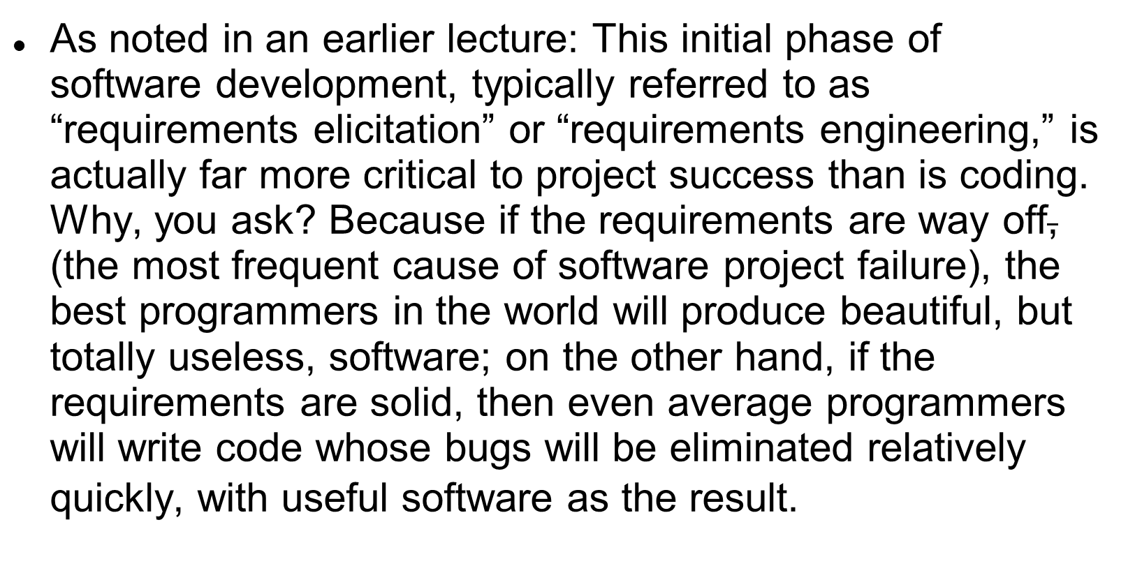
Requirements Engineering (Cont.)
CS574 Object-Oriented Analysis & Design

Slide 8
Requirements Engineering (Cont)
CS574 Object-Oriented Analysis & Design
So… Q. what else was/wasn’t in (some) class members’ first versions/iterations of the use cases and the use case text that doesn’t quite jibe with what the project client wants:
  A. First, in some first iterations/versions there were definitely use cases other than Create Account, Login, and Logout that weren’t wanted, and, in some, use cases that were wanted/needed were missing.
  But, first, let’s discuss aspects of the style of the use cases and of the use case text that weren’t sufficiently clear enough to make the use cases unambiguous/clear. (See next slide.)

Slide 9
Requirements Engineering (Cont.)
CS574 Object-Oriented Analysis & Design
The homework indicated that the use case text should be of the following form
    Actor 1 does X1
    Actor 2 does X2
    Actor 1 does X3
    Actor 2 does X4
    …
This is necessary in order to make the use case text as understandable/unambiguous as possible. But the use case text in some homework submissions was not in this style, and was, often, unclear because it wasn’t.

Slide 10
Requirements Engineering (Cont.)
CS574 Object-Oriented Analysis & Design
A smaller issue is that the name of a use case should start with a verb, because a use case describes something that the the desired software should allow the user, or some other actor, to do. So, for example, neither “Account” nor “Saved Search” is a reasonable name for a use case.

Slide 11
Requirements Engineering (Cont.)
CS574 Object-Oriented Analysis & Design
Before we get to needed/required use cases that were missing from some submissions, let’s have a look at some types of additional use cases that aren’t wanted/need, but were in some homework submissions:
  Buy Item
  Sell Item
  View Cart
  Edit Cart
  Check Out

Slide 12
Requirements Engineering (Cont.)
CS574 Object-Oriented Analysis & Design
These use cases are not needed/wanted, because the app is all about saving as many search patterns as desired, whereas
  the eBay website limits the number of search patterns that a user with an account may store,
  and the client wants to be able to save lots more search patterns.
  and the user can go to his/her eBay website account if s/he wants to buy or sell something
  and the client wants to be able to perform searches on all saved search patterns by clicking on a single button.
Also, if the client has n saved search patterns he wants to get all new matches to those saved search patterns on a single scrollable screen, rather than in n separate emails, the way eBay saved search patterns work.
And, the reason he wants all of these functionalities is in order to save time, so the app is about wanting to save lots of search patterns and to save time viewing matches. (See slides 9 and 10 in lecture 4.)

Slide 13
Requirements Engineering (Cont.)
CS574 Object-Oriented Analysis & Design
So, Save Search Pattern, which will enable the user to construct and save a search pattern is obviously required in order to satisfy the client’s needs. (This use case might also be called Add Saved Search Pattern or Construct Saved Search Pattern.)
If we had the time for a few more iterations, class members would find additional use cases that are necessary in order to satisfy the client’s needs.
But, there’s sufficiently more that we want to cover before the end of the semester, so we’ll discuss these additional uses cases on the next few slides. (Some class members might want to try to imagine what these additional use cases might be before going to the next slide.)

Slide 14
Requirements Engineering (Cont.)
CS574 Object-Oriented Analysis & Design
At some point in time the user will probably have to modify some saved search patterns, because their initial versions don’t exactly define what s/he is looking for on eBay, it will be necessary to have an Edit Saved Search Pattern use case. (This use case might also be called Edit Search Pattern.)
Can you think of any other use cases that will be needed?

Slide 15
Requirements Engineering (Cont.)
CS574 Object-Oriented Analysis & Design
Because the client may eventually lose interest in matches to one or more saved search patterns, it will be necessary to have a Delete Saved Search Pattern use case. (This use case might also be called Delete Search Pattern .)
The next slide describes some details of the Save Search Pattern use case that you might not have considered.

Slide 16
Requirements Engineering (Cont.)
CS574 Object-Oriented Analysis & Design
The Save Search Pattern use case should enable the user to construct and save either a simple or an advanced search pattern because the client currently constructs both types of a search patterns when he uses the eBay website directly.

Slide 17
Requirements Engineering (Cont.)
CS574 Object-Oriented Analysis & Design
There also, clearly, has to be a Perform Search use case.

Slide 18

CS574 Object-Oriented Analysis & Design
The eBay Application ‏
Where did all of this come from?
It came from the description -- copied from an earlier lecture to the next few slides -- of why the client wanted the app.
As is usual with a client, he didn’t go into more detail because he expected it to be obvious to the developers…which frequently (almost always?) happens when the developer doesn’t know the client’s domain very well – or at all.

Slide 19
CS574 Object-Oriented Analysis & Design
eBay Application (cont.)‏
Here’s my situation:
  I’m a very serious collector of books and other items on a number of subjects outside of computer science
  I buy most of my books from such venues as www.abebooks.com, and www.amazon.com, and from stores that sell used books. I buy other things of interest from various other venues.
  Quite frequently, however, very scarce items that never show up on abebooks or amazon, in bookstores or in other types of stores, do show up on eBay auctions, and I want to find these auctions so that I can bid, and hopefully win/buy those items.

Slide 20
CS574 Object-Oriented Analysis & Design
eBay Application (cont.)‏
Here’s my problem:
  eBay lets users store saved search patterns, and sends the user an email, each day, listing newly posted items that match each saved search pattern. (eBay refers to these as “saved searches,” but I prefer to call them “saved search patterns.”)
  My first problem is that ebay only lets you store about 100 saved search patterns, and I have a few hundred, each of which I have to enter manually to search on. Doing so can take me hours.
  My second problem is that I have to open as many emails as there are saved search patterns that have new matches.
  My third problem is that if a saved search pattern has more than 20 new matches, I have to go to eBay’s web site to see all but the first 20.

Slide 21
CS574 Object-Oriented Analysis & Design
eBay Application (cont.)‏
Here’s how I’d like to solve my problem:
  I want a desktop application that lets me store as many saved search patterns as I want and will search on all of them when I push a “search” button.
  Each time the application has finished its searching, it will show me only new matches, i.e., matches that it hasn’t shown me before – just as the eBay saved search pattern emails do.
  That way all I have to do is push a button and I’m free to do something else while the application is doing the work of finding all new matches to all of my saved search patterns. Once the application has finished I can review all new matches by scrolling down a single GUI page.

Slide 22
Midterm Exam
Construct a full GUI prototype for the eBay application, including use cases, use case text, and screen shots.
Be sure to use the type of use case text described on slide 9.
Be sure to realize that there are 3 actors here: the user, the eBay app, and the eBay website, from which the eBay app finds matches to saved search patterns.
Be sure to include all alternate courses that you can think of.
Only MS Word and PPT submissions will be accepted.
Be sure to put your full name at the beginning of the document
Be sure to name the document with your family name followed by your personal name.

